Slide 1
Optimizing Tweets for Engagement on the Topic of HIV and AIDS
Sahar Manavi
Springboard
May 2021

Slide 2
Goals for this project
Identify phrases and hashtags
That predict higher engagement (favorites, retweets, replies, and quote tweets)
For tweets on the topic of HIV and AIDS.

Slide 3
Background and Reasoning
The HIV/AIDS community on Twitter is relatively small and it’s rare for tweets on the topic to have broad appeal outside of that community.
However, there are still “celebrities” or more popular tweets and topics within the community.
Donors looking to help organizations will be knowledgeable of and looking within the community to find groups to support.
Therefore, establishing credibility and having broad reach within the community is important.

Slide 4
Query Generation Strategy
Exploratory data analysis of these tweets
Tweets gathered using generic query
Tweets of top posters
Build generic query
Identify top posters in this query
50,000 tweets
Run query using various versions of the API
Manually curate query words to ensure on-topic results
NLP analysis to ID most used words and phrases

Slide 5
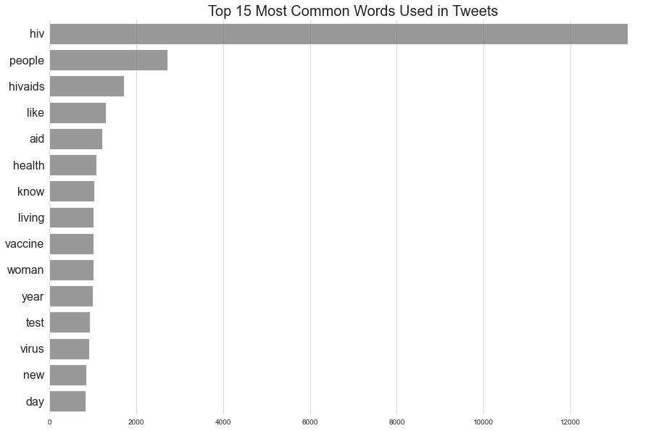
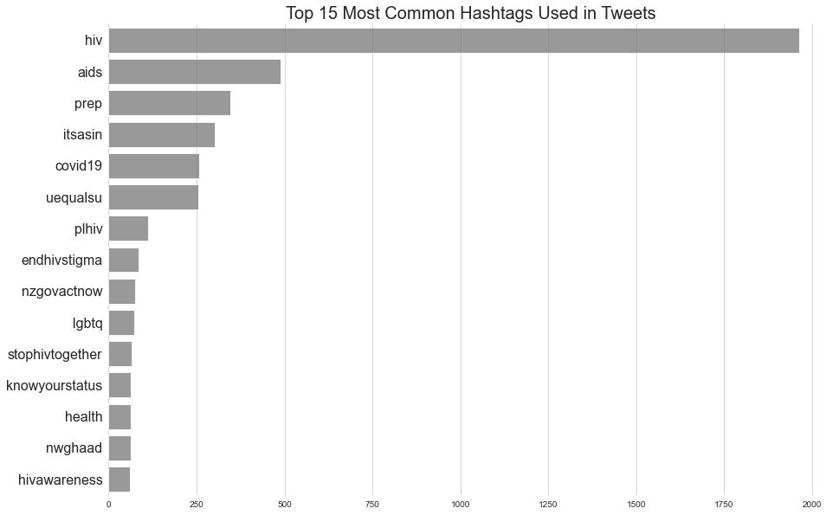
Final dataset
17,924 unique tweets from 12,674 unique users

Slide 6
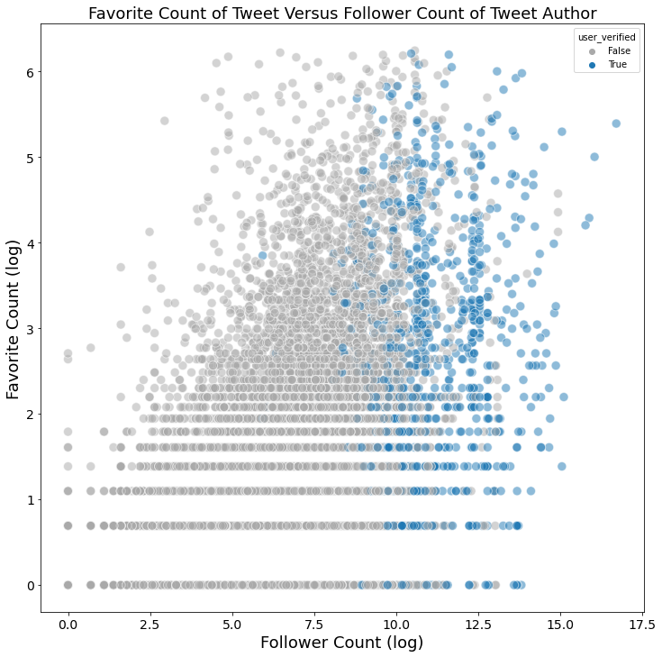
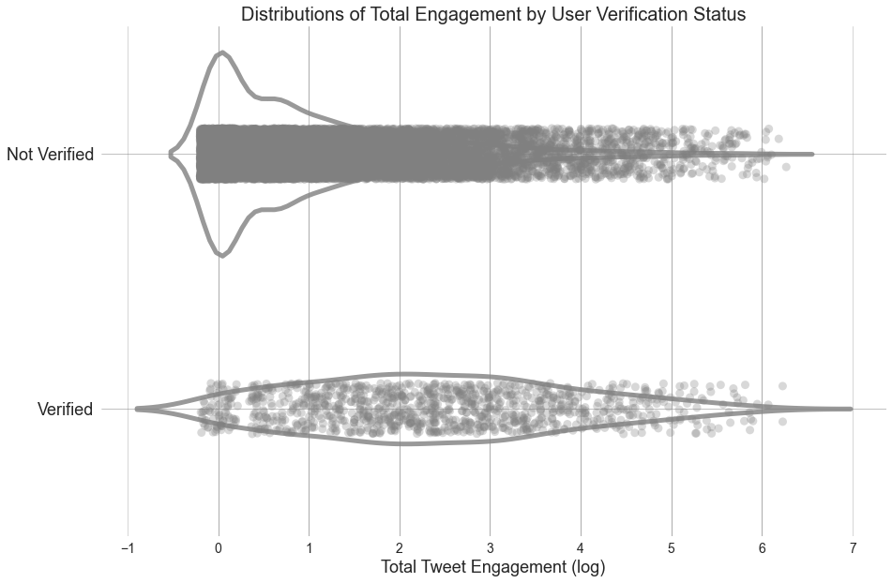
Follower Count and Verification Status

Slide 7
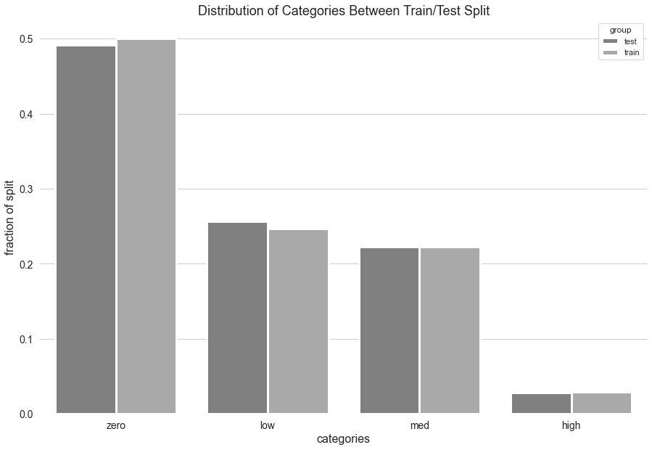
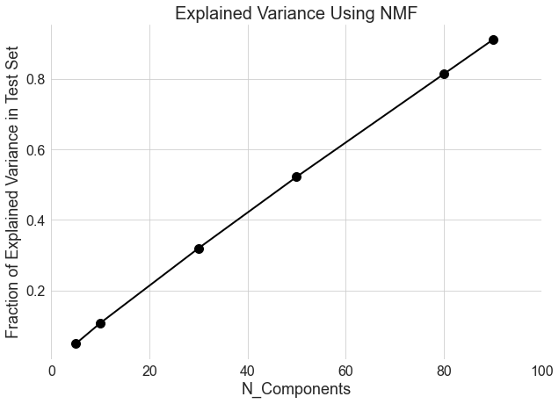
Data Pre-processing

Slide 8
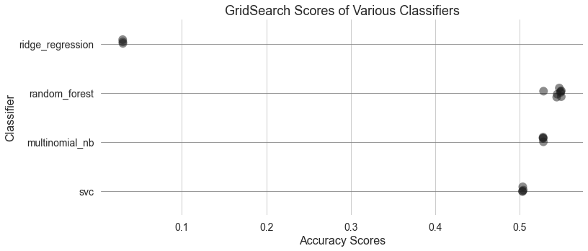
Model Performance

Slide 9
Conclusion
There does not appear to be an underlying pattern to the data.
Possible explanations:
Engagement is mostly random and/or based on what the underlying Twitter algorithm chooses to prioritize.
A necessary aspect of my data collection (spreading it out over time) created too much topic randomness, since Twitter topics have their own lifecycle.

Slide 10
Future Directions
Neural network/deep learning.
Try resampling to even out classes.
Change categories to be binary.
Different features that aren’t all text dependent.

